Slide 1
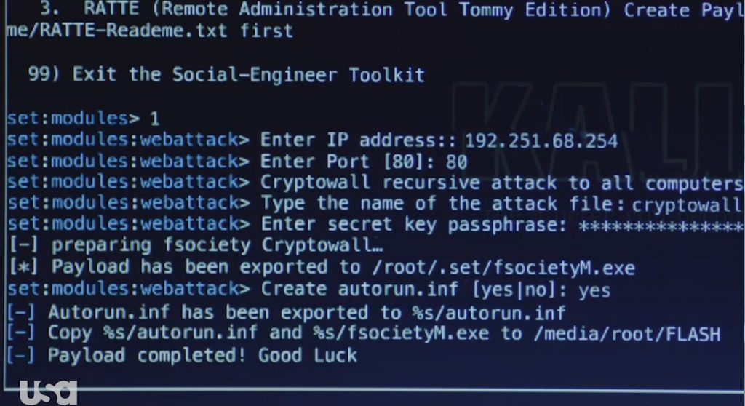
IEEE
CITING & REFERENCING

Slide 2

Overview
the purpose of citing and referencing in academic writing
when and how to properly cite your sources
what kinds of information require citation
how to integrate quotes and other information into your writing
basic IEEE citation guidelines.

Slide 3
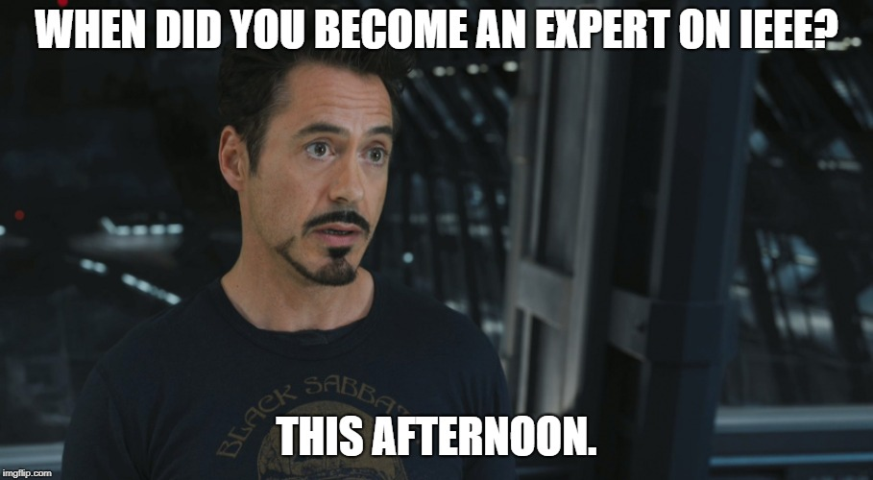

Slide 4

In-Text Citations: These are short [bracketed] notes that indicate when an idea presented in your writing relies upon the work/thinking of another.
CITING AND REFERENCING
Wang et al. [1], in the article “If at First You Don’t Succeed, Call It 1.0: The Trials and Tribulations of Writing New Programs,” review case studies that detail the coding process.
Wang et al. [1] review case studies the detail that coding process.
References: These are detailed notes at the end of the paper that identify the authors, titles, publishers, and any other important information about the resources you have consulted.

Slide 5
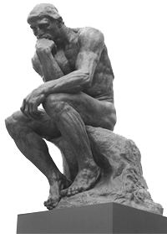
Why Cite?

Slide 6
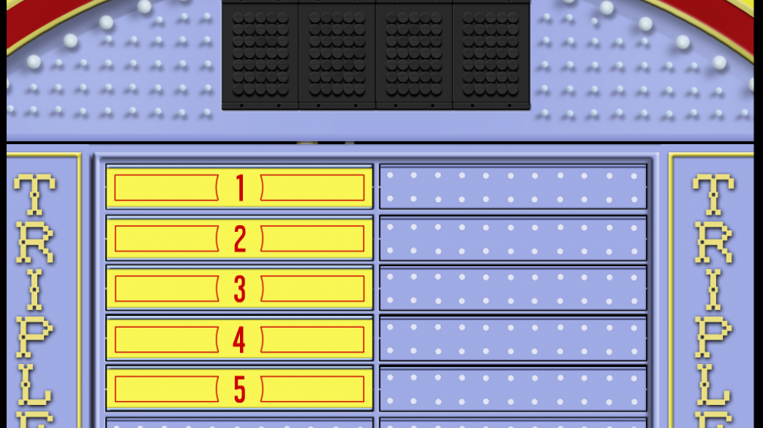
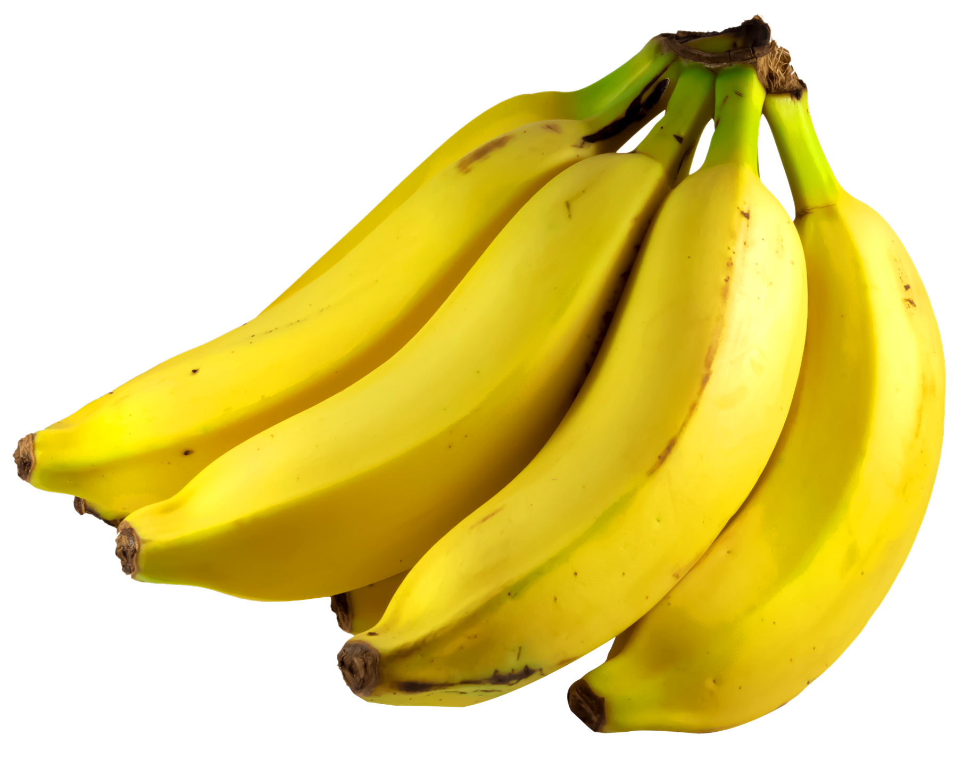
Avoid Plagiarism
Give Credit to Others
Validate Claims
Scholarly Credibility
Reading List

Slide 7
Plagiarism
“The act of copying, reproducing or paraphrasing significant portions of one’s own work, or someone else's published or unpublished material… without proper acknowledgment, representing these as new or as one's own.”
- University of Windsor Student Code of Conduct

Slide 8
UNINTENTIONAL PLAGIARISM
1
2
3
Self Plagiarism
Missing Quotes
Uncited Paraphrasing

Slide 9


Self Plagiarism
Second Year
You are presenting old ideas as new.
You are cheating yourself out of a learning opportunity.
First Year

Slide 10
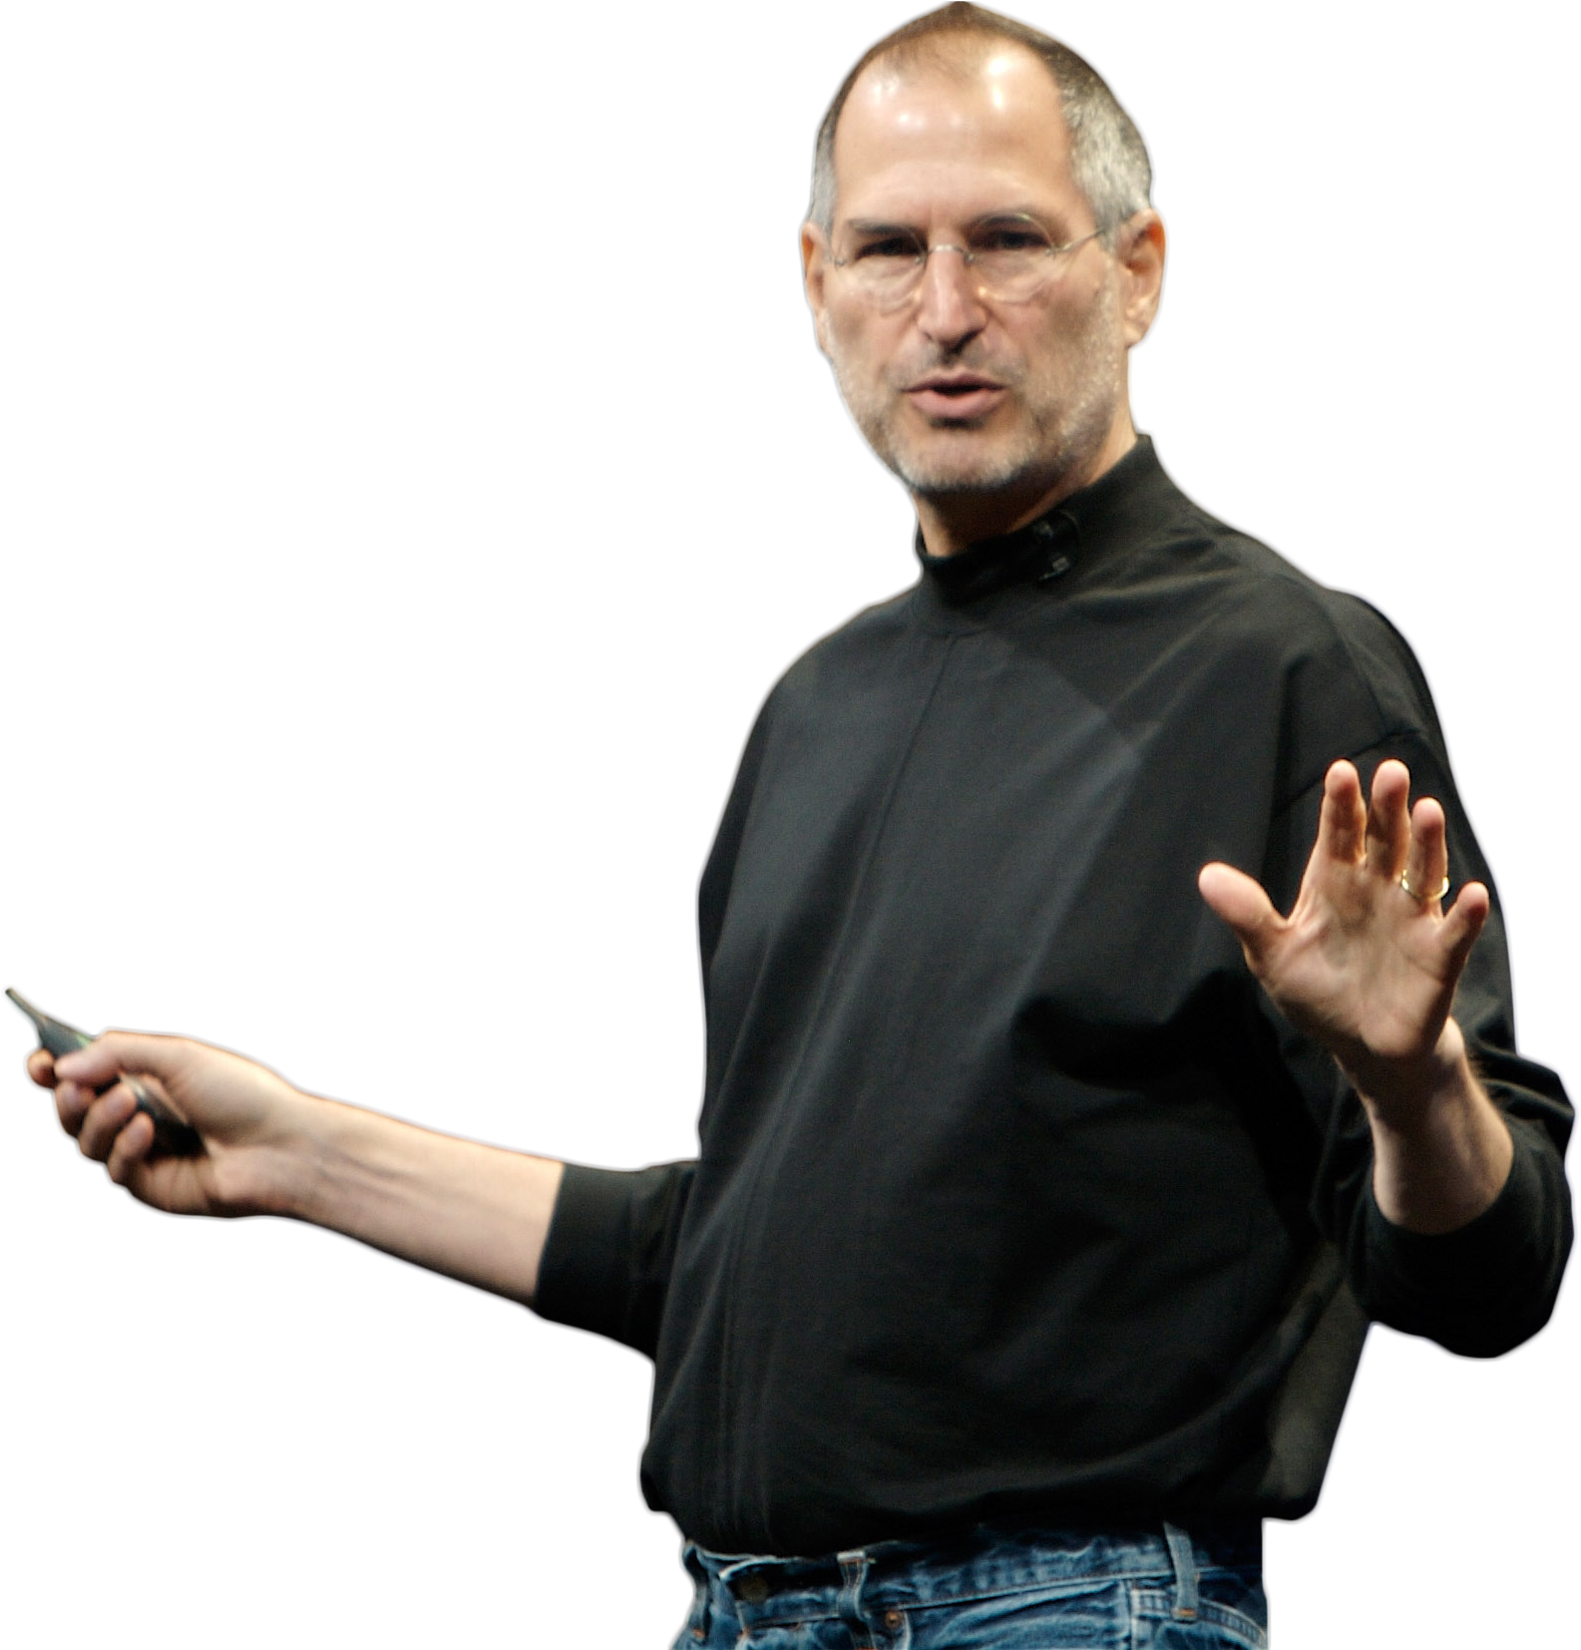
Missing Quotes
I think everybody in this country
should learn how to program a computer because it teaches you how to think.
Steve Jobs believes that every American should learn how to program a computer because it teaches you how to think [1].

Slide 11
Missing Quotes
I think everybody in this country
should learn how to program a computer because it teaches you how to think.
Steve Jobs believes that every American should learn how to program a computer because it teaches you how to think [1].
Steve Jobs believes that every American “should learn how to program a computer because it teaches you how to think” [1, p. 3].

Slide 12


Uncited Paraphrasing
The words are yours.
However,
the ideas belong to somebody else.
THEREFORE,
YOU
MUST
CITE!
NO CITATION

Slide 13
Repercussions
Admonition/censure
Letter of apology/reflection
Educational session
Repeating assignment
Mark reduction
Denial of registration
Suspension
Expulsion
Rescinding degree
Senate Bylaw 31

Slide 14

When to Cite?

Slide 15

ANSWER
You need to provide citations and references whenever an idea you present or statement you make is dependent on the work of others.

Slide 16
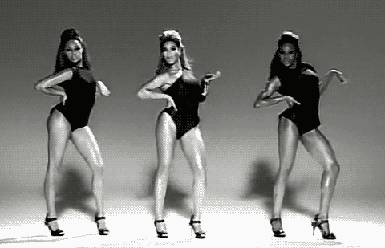
Beyoncé
“If you liked it then you should have put a citation on it.”

Slide 17
Two Instances
Direct Quotes
Paraphrased Passages

Slide 18



Direct Quotes
#
Three significant words or more require “quotation marks.’’
You need a name and page number
In most cases, paraphrasing is preferred.
Ideal for lists of academic terms or definitions.

Slide 19





Paraphrasing
Paraphrasing
Frame ideas from the source in your own words.
Creates consistency when citing material is written in a different tense or perspective.

Slide 20
HOW TO PARAPHRASE
Re-Ordering
1
Reducing Adjectives
2
Reducing Adverbs
3
Alternate Language
4
Word Reduction
5

Slide 21
Re-Order Phrases/Clauses
1
Look for verbs
Look for conjunctions
Look for prepositions
Look for punctuation

Slide 22
Example
Instead of negatively impacting its
Instead of negatively impacting its
the chemicals
quickening growth, the chemicals
quickening growth,
, and
positively affected the process, and
positively affected the process
production
of
the
this can make the production of the
this can make the
product quicker.
product quicker

Slide 23
Example
Instead of negatively impacting its
The chemicals positively affected the
instead of negatively impacting
quickening growth,
the chemicals
process
.
positively affected the process
, and
Its quickening growth
can make the
product’s production
production
of
this
the
This
quicker.
product quicker.

Slide 24
Reducing Adjectives
4
Delete if unnecessary
Use more specific nouns to eliminate adjective
Young child
Toddler

Slide 25
Reducing Adverbs
3
Delete if unnecessary
Use more specific verbs/adjectives to eliminate adverbs
Very important
Critical

Slide 26
Example
facilitated the
The chemicals
positively affected the
process instead of
negatively impacting
inhibiting
its quickening growth. This can make
the product’s production quicker.

Slide 27
Alternate Language
4
Identify non-core language
Consider other words choices

Slide 28
Example
The chemicals facilitated the
process
procedure
inhibiting its
quickening
instead of
rapid
rather than
growth.
This can
quicken
the
expansion.
which can
make
expansion,
product’s production quicker.
product’s production.

Slide 29
Word Reduction
6
Identify redundancies
Delete unnecessary words

Slide 30
Example
The chemicals facilitated the
procedure
rather than
inhibiting its
rapid
expansion,
which can
quicken
the
production.
product’s production.

Slide 31
Comparison
Before
After
Instead of negatively impacting its quickening growth, the chemicals positively affected this process, and this will make the production of the product more efficient.
The chemicals facilitated this procedure, rather than inhibiting its rapid expansion. This can quicken the production.

Slide 32
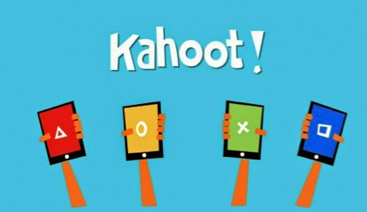

Slide 33

What Gets Cited?

Slide 34

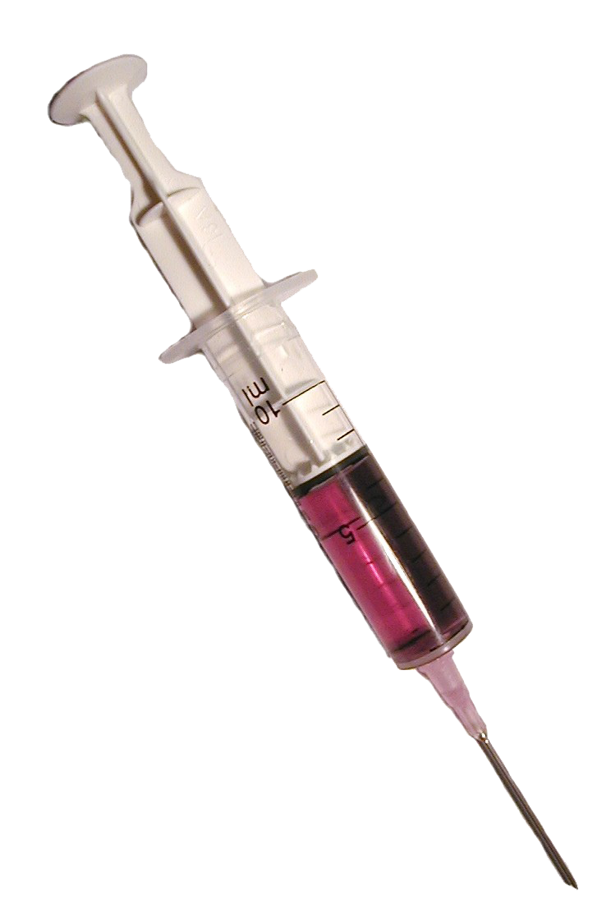




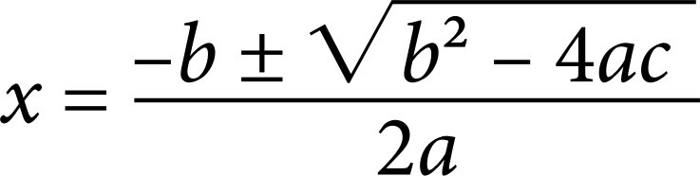
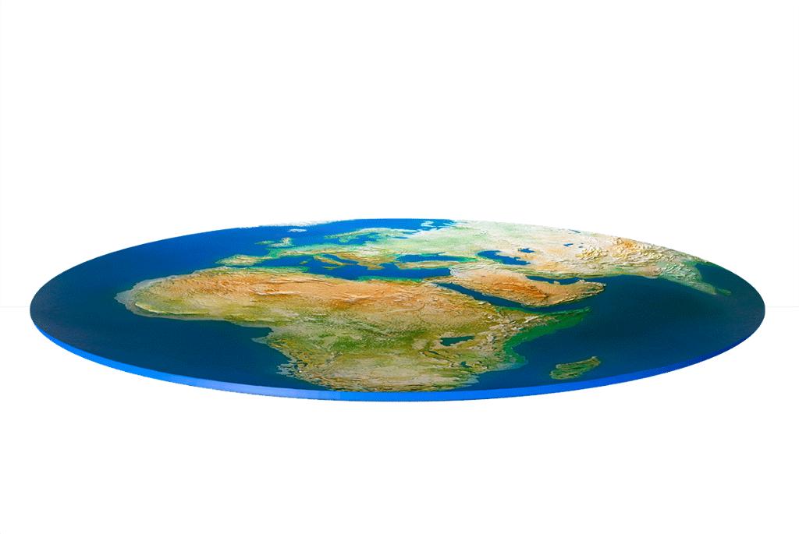

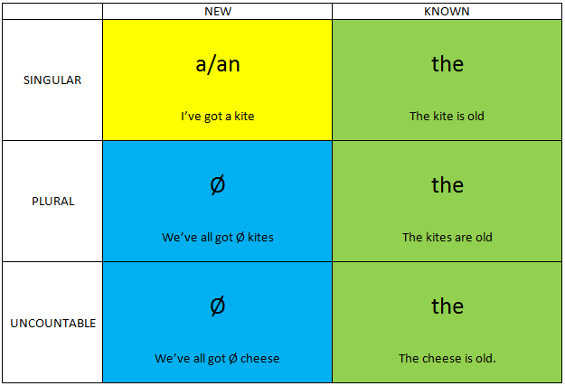
To Cite, or Not to Cite?
TOTALS
WHAT TO CITE
%
Any original idea or research!
MOST
Uncommon knowledge
Contested theories/facts
Statistics
Images/graphs/table
Other’s perspectives
Specific words/phrases
>50%
AVERAGES

Slide 35



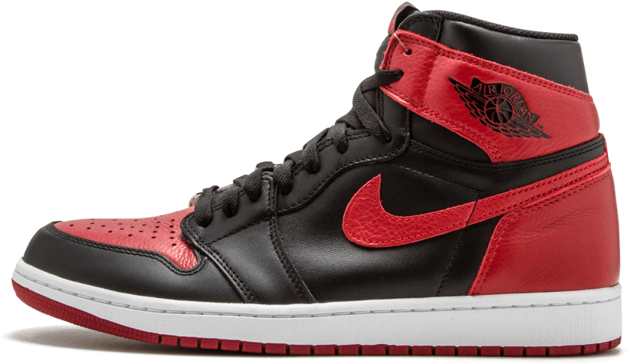




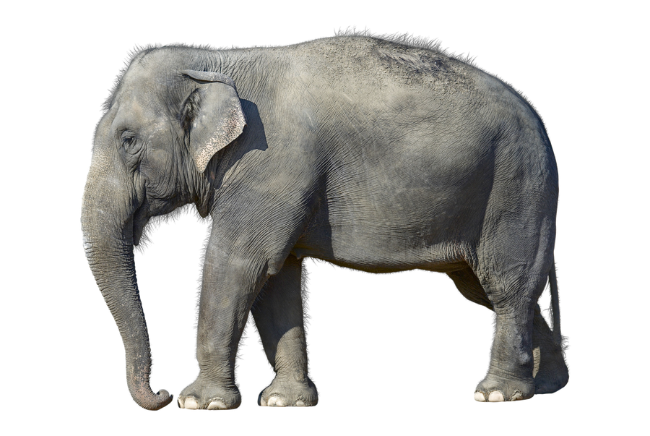

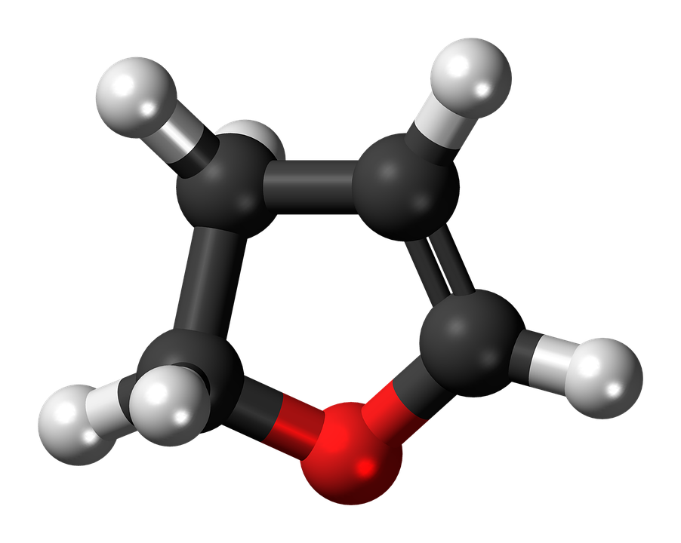





To Cite, or Not to Cite?
Alternately
WHAT NOT TO CITE
Informal
Common knowledge
Common opinions
Proverbs, idioms, expressions
Notes
Casual
Encounters
Colloquial

Slide 36

Not sure if you need a citation?
CITE ANYWAY!

Slide 37

HOW TO CITE

Slide 38

QUOTES
Heilmann [1, p. 45] argues that “Java is to JavaScript what car is to Carpet.”
Heilmann argues that “Java is to JavaScript what car is to Carpet” [1, p. 45].
or
COMMON APPROACH

Slide 39
Does the text span over two pages?
Heilmann argues that “Java is to JavaScript what car is to Carpet” [1, pp. 45-46].

Slide 40
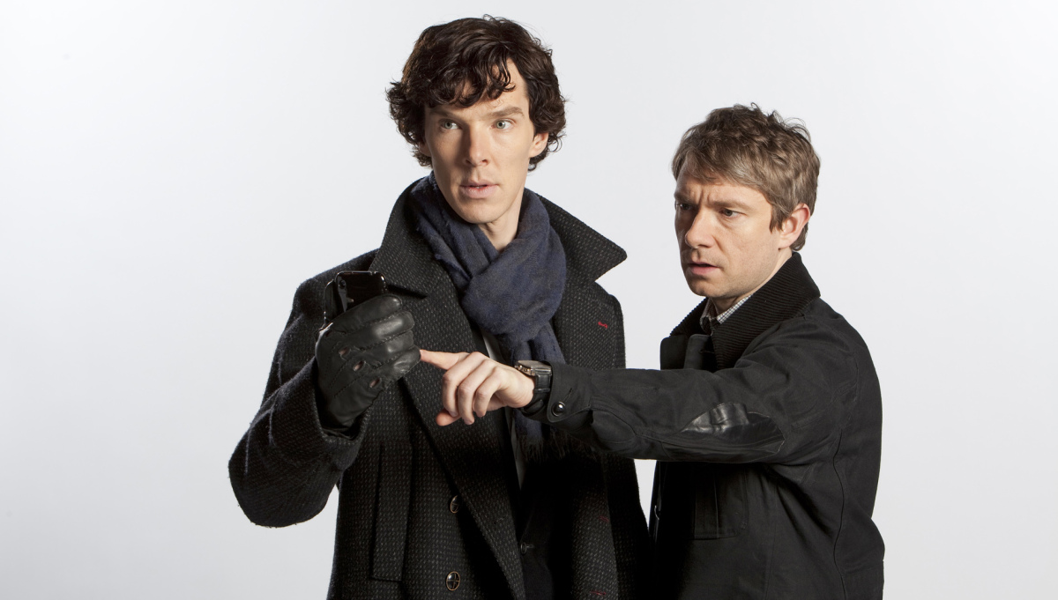
Paraphrased Passages
Holmes and Watson [2] suggest that deductive reasoning can help solve crimes.
With IEEE, it is common practice to omit authors’ names.
or
Deductive reasoning can help solve crimes [2].

Slide 41



Multiple Sources
SEQUENTIAL
There are only 10 kinds of people in this world: those who know binary and those who don’t
[3]-[6].
[3-6].
NON-SEQUENTIAL
No one survived the binary war
[3], [5], [8].
[3, 5, 8].

Slide 42

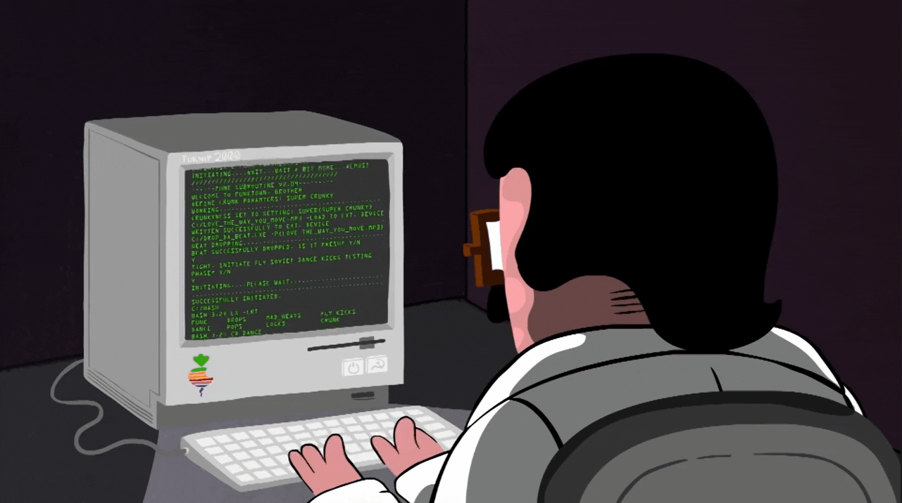
The reader doesn’t see your contribution.
Where does the citation go?
1
If you add commentary after a citation within the same sentence,
insert the citation where the source’s information ends
and before your commentary begins
so that the two are not confused.
The data seem misinterpreted or misrepresented.
2
Example: Assembly programmers work below C-level [3]; therefore, their computers should be waterproof.
Example: Assembly programmers work below C-level; therefore, their computers should be waterproof [3].

Slide 43
Citing Specific Content
Paragraph: [1, para. 5]
Appendix: [5, Appendix VII]
Figure: [2, Fig. 52]
Algorithm: [6, Algorithm 7]
Table: [3, Table IV]
Example: [7, Example 1]
Equation: [4, eq. (17)]
Section: [8, Sec. 3.1]

Slide 45
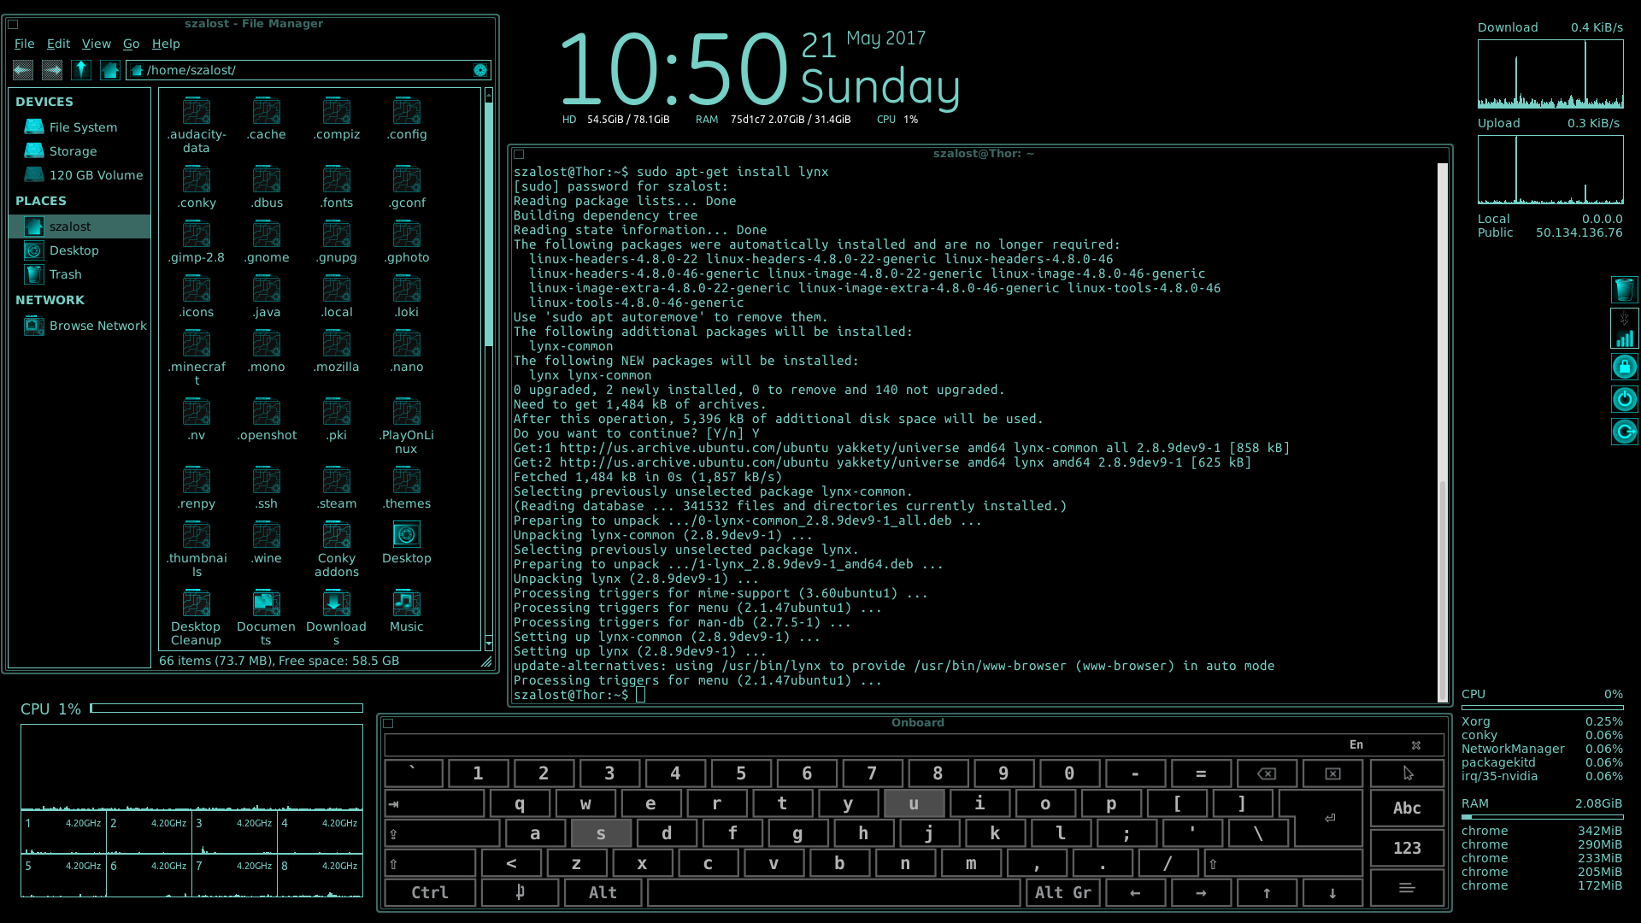
References

Slide 46

Preparing a Reference List
SOURCE?
A book? A website? A scholarly article?
LOCATION?
Journal? Book? Publish? Electronic location?
DATE?
Year? Month? Day? Volume? Issue?
AUTHORSHIP?
Authors? Translators? Editors? Organizations?

Slide 47
Author
Title
Location
Date

Slide 48
Example: Online Journal
[1]
Numeric
Designation
Note: You’ll begin with the numeric designation based on order of appearance.

Slide 49
Example: Online Journal
[1]
N. Tesla,
Author
Numeric
Designation
Note: The initial of the given name comes first, followed by the surname name, which is closed with a comma.
Note: You’ll begin with the numeric designation based on order of appearance.

Slide 50
Example: Online Journal
[1]
N. Tesla,
A. Bell, and E. Musk,
Author
Note: Up to six authors, include them all in order of appearance.
Note: The initial of the given name comes first, followed by the surname name, which is closed with a comma.

Slide 51
Example: Online Journal
[1]
N. Tesla,
et al.,
A. Bell, and E. Musk,
Author
Note: More than six authors, use the first name with ‘et al.’
Note: Up to six authors, include them all in order of appearance.

Slide 52
Example: Online Journal
[1]
N. Tesla,
et al.,
“Transporter or duplicator: The
magic of science,”
Author
Title
Note: More than six authors, use the first name with ‘et al.’
Note: The title of the article follows the name of the author.

Slide 53
Example: Online Journal
[1]
N. Tesla,
et al.,
“Transporter or duplicator: The
magic of science,”
Magical Engineers Quarterly,
Title
Journal
Note: The title of the article follows the name of the author.
Note: The name of the journal follows title of the article.

Slide 54
Example: Online Journal
[1]
N. Tesla,
et al.,
“Transporter or duplicator: The
magic of science,”
Magical Engineers Quarterly,
Italics vs.
Quote Marks
Title Case vs.
Sentence Case
Capitalization
What is the difference between how
we have formatted
the titled of the article and
the name of the journal?
Journal
Note: The name of the journal follows title of the article.

Slide 55

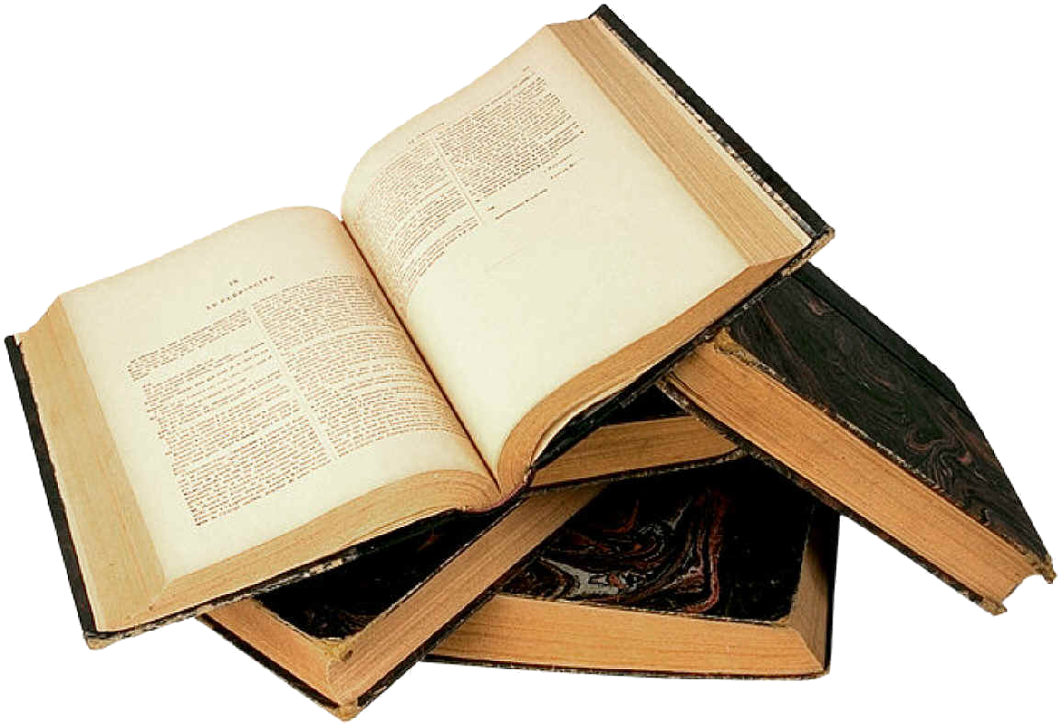
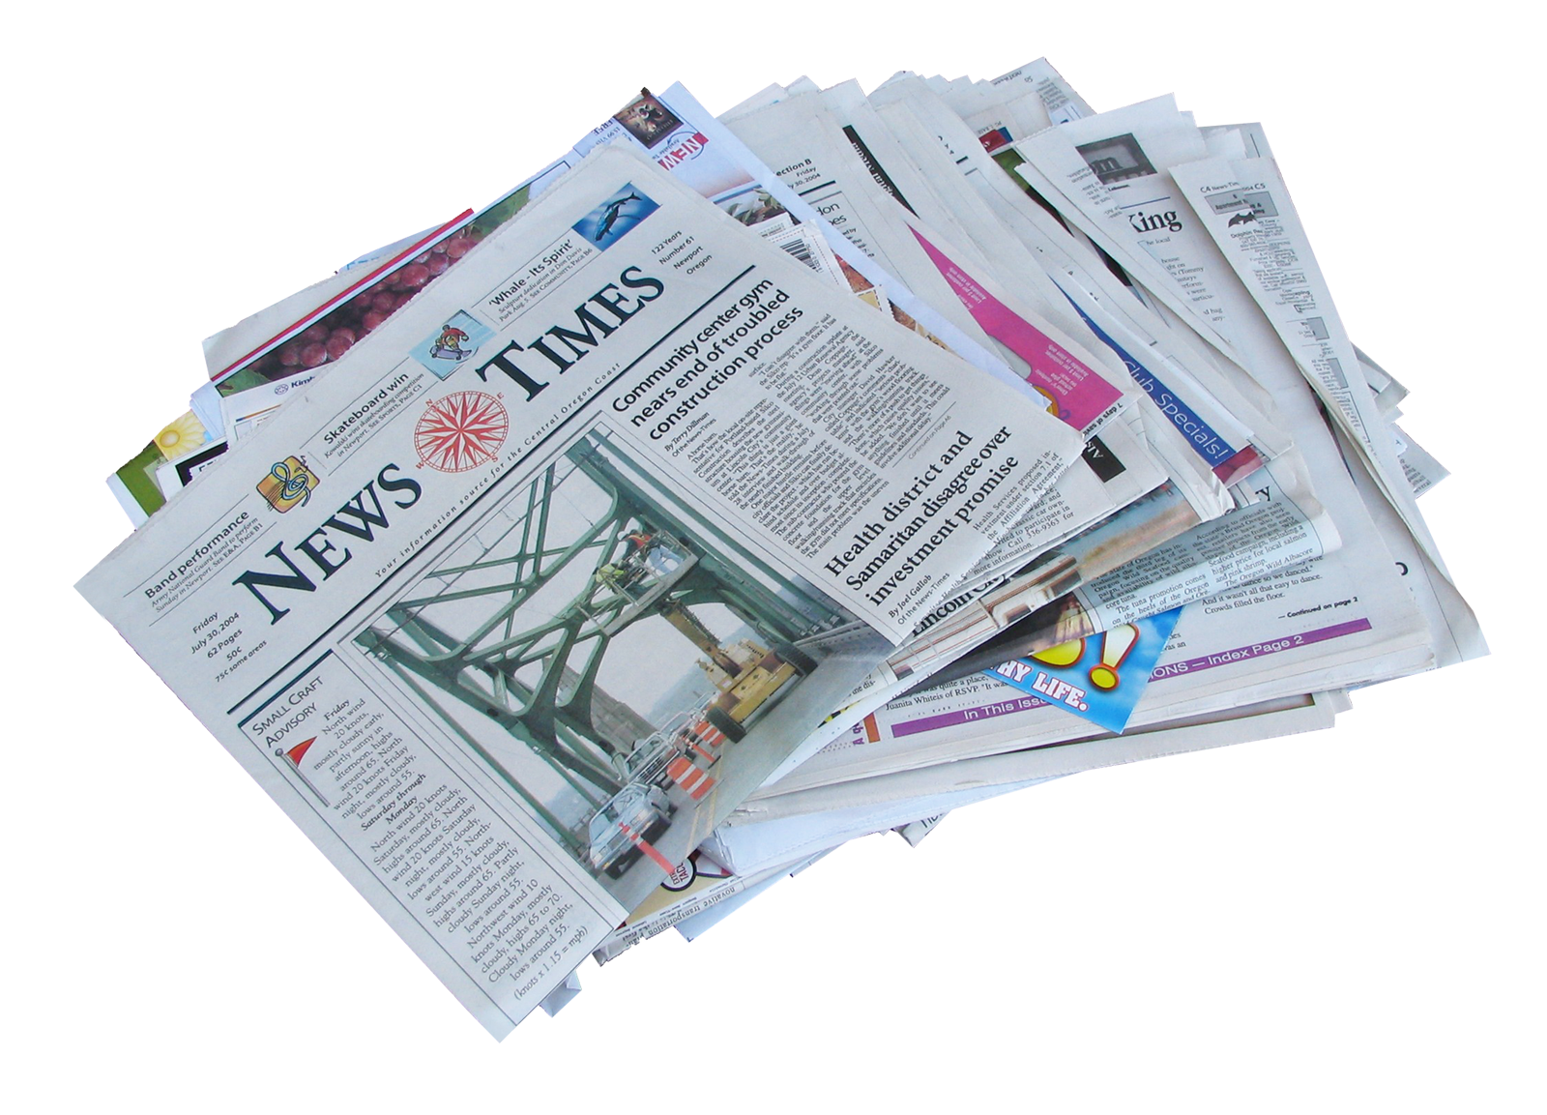
Example: Online Journal
[1]
N. Tesla,
et al.,
“Transporter or duplicator: The
Chapters
Articles
magic of science,”
Magical Engineers Quarterly,
Italics vs. Quote Marks
Italics vs.
Quote Marks
Title Case vs.
Sentence Case
Capitalization
Italics!
Large works are italicized.
Small works go in quotes.

Slide 56
Example: Online Journal
[1]
N. Tesla,
et al.,
“Transporter or duplicator: The
magic of science,”
Magical Engineers Quarterly,
Italics vs. Quote Marks
Title Case vs. Sentence Case
Large works are italicized.
Journals’ names get title case.
Small works go in quotes.
Article titles get sentence case

Slide 57
Title Case
The Journal of Computing and Coding in the 21st Century
EXCEPTIONS!
Capitalize everything accept
Coordinating conjunctions
Short prepositions
The articles ‘the,’ ‘a’, and ‘an.’
Always capitalized the first word or first word of a subtitle.

Slide 58
“User hostile design: Why you should avoid Apple products”
Sentence Case
Note: You will ONLY capitalize
the first word
the first word of the subtitle, and
proper names, initializations, and acronyms.

Slide 59
Example: Online Journal
[1]
N. Tesla,
et al.,
“Transporter or duplicator: The
magic of science,”
Magical Engineers Quarterly,
vol. 1,
no. 1,
Location
Note: The volume and issue number follow preceded by the abbreviations ‘vol.’ and ‘no.’ respectively.

Slide 60
Example: Online Journal
[1]
N. Tesla,
et al.,
“Transporter or duplicator: The
magic of science,”
Magical Engineers Quarterly,
vol. 1,
no. 1,
pp. 3-14,
Location
Note: The volume and issue number follow preceded by the abbreviations ‘vol.’ and ‘no.’ respectively.
Note: This is followed by the page ranges, which is preceded by ‘pp.’

Slide 61
Example: Online Journal
[1]
N. Tesla,
et al.,
“Transporter or duplicator: The
magic of science,”
Magical Engineers Quarterly,
vol. 1,
no. 1,
pp. 3-14,
Aug. 2021.
Location
Note: This is followed by the page ranges, which is preceded by ‘pp.’
Date
Note: The month and year close out the citation.

Slide 62
Example: Online Journal
[1]
N. Tesla,
et al.,
“Transporter or duplicator: The
magic of science,”
Magical Engineers Quarterly,
vol. 1,
no. 1,
pp. 3-14,
Aug. 2021.
doi: 001001101
Date
Note: The month and year close out the citation.
E-Source
Note: For online sources, the DOI number follows.
DOI= Digital Object Identifier

Slide 63
Example: Online Journal
[1]
N. Tesla,
et al.,
“Transporter or duplicator: The
magic of science,”
Magical Engineers Quarterly,
vol. 1,
no. 1,
pp. 3-14,
Aug. 2021.
doi: 001001101
www.doi.org.001001101
E-Source
Note: For online sources, the DOI number follows.
DOI= Digital Object Identifier
Note: Can’t find the DOI number?
Use the DOI link!

Slide 64
Example: Online Journal
[1]
N. Tesla,
et al.,
“Transporter or duplicator: The
magic of science,”
Magical Engineers Quarterly,
vol. 1,
no. 1,
pp. 3-14,
Aug. 2021.
www.thisisfake.com
www.doi.org.001001101
E-Source
Note: Can’t find the DOI number?
Use the DOI link!
Note: Can’t find either?
Use the URL!

Slide 65
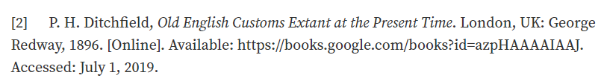
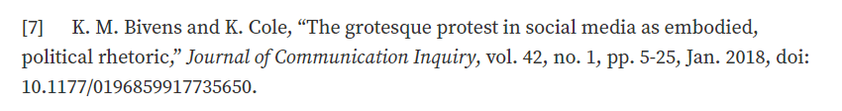
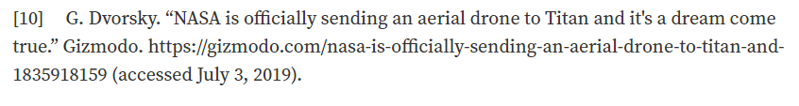
INCONSISTENCIES

Slide 66

What do you do?

Slide 68
Additional Resources
OWL Purdue:
https://owl.purdue.edu/owl/research_and_citation/ieee_style/ieee_overview.html
Box Hill Institute: https://libguides.bhtafe.edu.au/IEEEreferencing
Murdoch University: http://libguides.murdoch.edu.au/IEEE
Victoria University: http://libraryguides.vu.edu.au/ieeereferencing

